Slide 1
3467 has entered the lobby!
3467 has entered the lobby!
…………………………………………………………………..

Slide 2
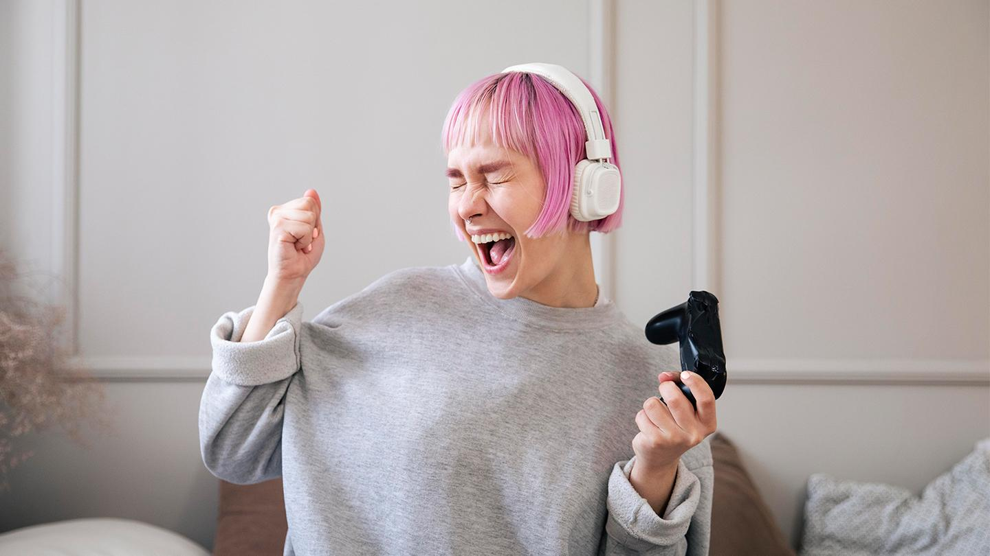
User Experience In Game Development
User Experience In Game
Development

Slide 3
Contents Of This Presentation
Contents Of This Presentation
Here’s what you’ll find in this presentation:
Terminology used
User Experience Evaluation
Methods used in evaluation phases
Dissecting a Game: Pacman
Heuristics
Conclusion
Resources Used
FAQs

Slide 4
The Terms
The Terms
Let’s familiarize ourselves with some of the terms

Slide 5

Terms to know
01
Games
02
User Experience
03
AI
Terms to know
01
Games
An activity with rules we perform to have fun.
02
User Experience
The user experience is how a user interacts with and experiences a product, system or service.
03
AI
Artificial intelligence is intelligence demonstrated by machines.

Slide 6

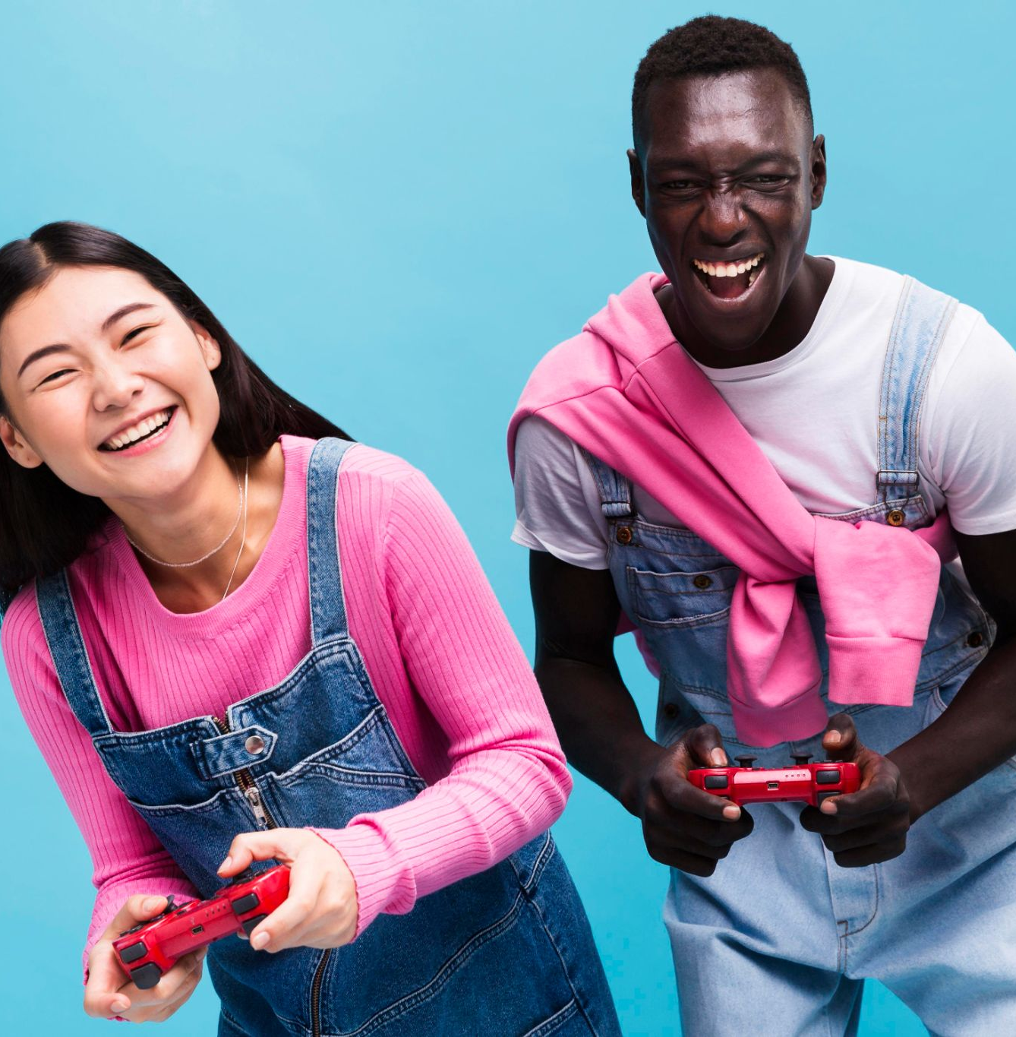
UX Evaluation
UX Evaluation
To configure the overview of user experience testing games:
• Concept
• Pre-production phase
• Prototype
• Production
• Local performance
• Alpha stage
• Beta Phase
• Gold
• Background production

Slide 7
Methods used in evaluation phases
Methods used in evaluation phases
1)Play tests including
biometric measurements
measurements include blood and , body mass index, and other physical assessments
2)(Semi-structured) interviews
3)Observation
4)Video coding
5)Quantitative comparisons of gamers’ behaviors
6)Questionnaire based on user attitudes,
experiences, etc.
7)Heuristic testing (including heuristics for playability, tabletop)
Usability inspection method

Slide 8
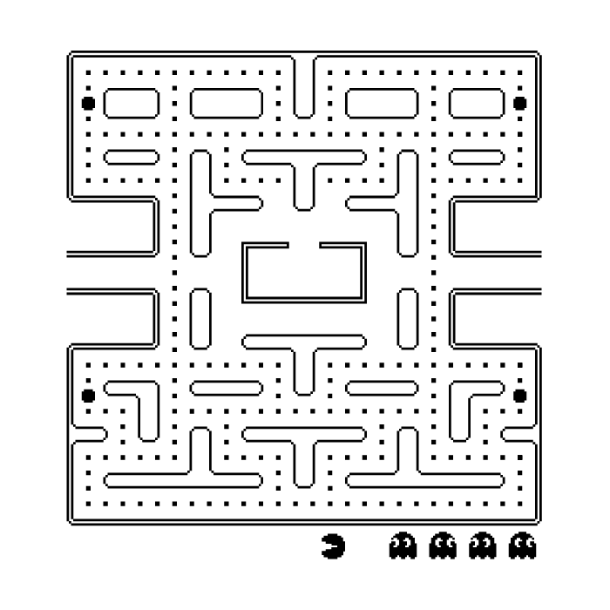
Pacman
Pacman
Dissecting Pacman
Chase Mode
Chase Mode
Frightened Mode
Frightened Mode
In chase mode, the ghosts will have different behaviours associated with their personalities.
In frightened mode, the ghosts will all turn dark blue and aimlessly wander around in the maze for a few seconds.
Scatter Mode
Ghost
Scatter Mode
Ghost
The ghost will give up the chase and head for the top left corner of the board using its regular path-finding methods.
Blinky (Red), Pinky (Pink), Inky (Cyan), Clyde (Orange)

Slide 9
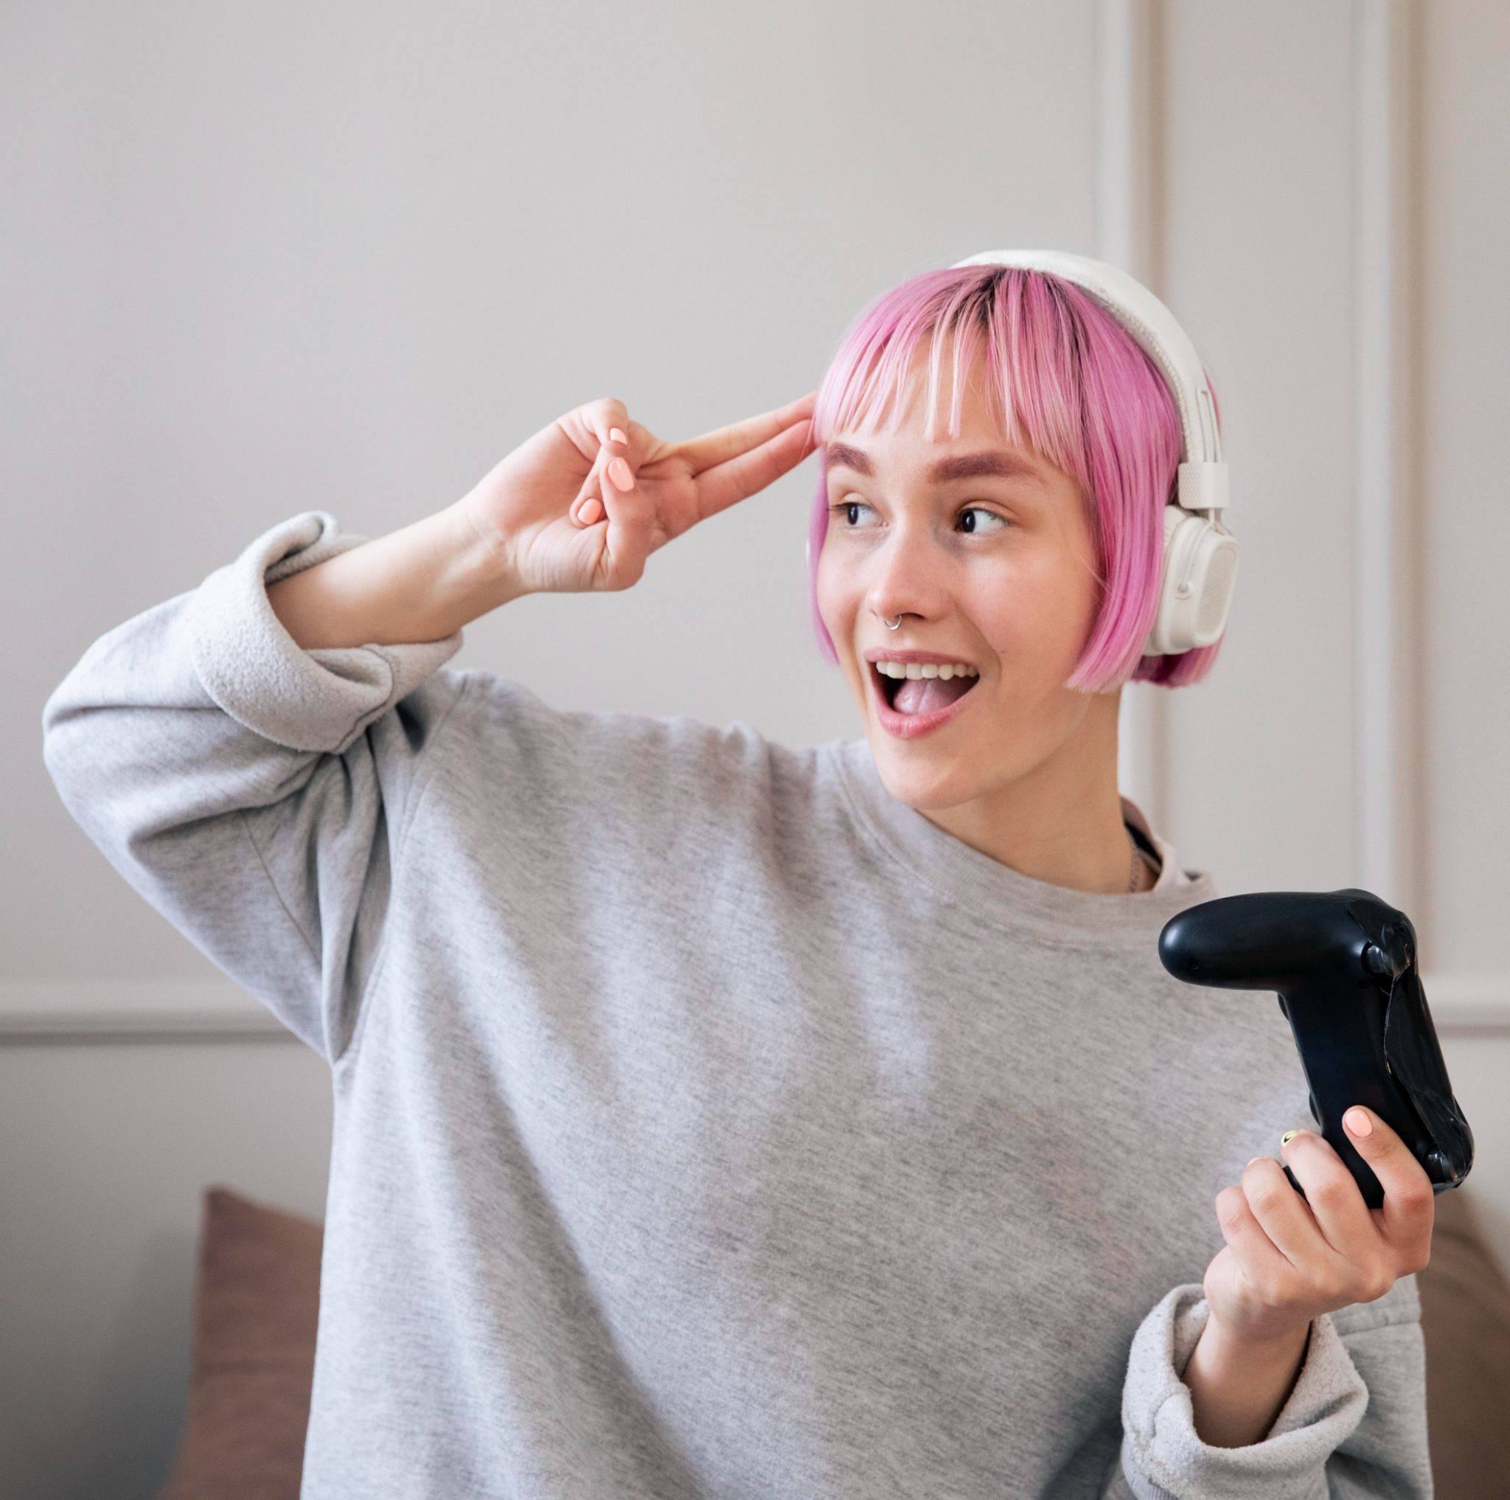
Heuristics
Heuristics
Heuristics related to game play and visual interface:
Comfort of the physical setup: The construction of the setup (including the display) should be comfortable to use and not require the player to take an awkward position
The game should be “quick to put pressure on but not frustrate the player”.
“Game mechanics should feel natural and have the right weight and energy.” In addition, they should fit the situation the user is facing.
“The artificial intelligence should be
reasonable”, “visible to the player,
consistent with the player’s
expectations” and “yet unpredictable”
Heuristic: involving or serving as an aid to learning, discovery, or problem solving by experimentally and especially trial and error methods

Slide 10
Heuristics
Heuristics
The game should be “paced to apply
pressure but not frustrate the player”
Examinability: The players should not be hindered to examine the area required by the
game play.
Adaptability: The system should be adaptable to the player in terms of the setup.
Feedback: Feedback and feedthrough should be adapted to the possibilities of tabletop
games, used adequately and provided to the players when appropriate.
“The game takes the player emotionally to the level of personal involvement (e.g., shock, threat, excitement, reward and punishment)”.

Slide 11
Conclusion
Conclusion
2)What the human development team could not perform on their own, AI has made possible.
4)Characters who can now self-learn from their actions and evolve as a result.
1)The future is unclear, but games that embrace new technologies and offer next-level competitiveness keep players interested.
3)The future has AI game developers make video games employing powerful AI approaches to plan strong frameworks within games.

Slide 12
Conclusion
Conclusion
A game might exist that can comprehend and react to your in-game activity, anticipate your next move, and behave accordingly. AI learns from a player's wins and defeats by determining where and how they occur. That is advanced evolution.

Slide 13
—Toru Iwatani,
1986 PacMan Designer
“I had no special training at all; I am completely self-taught. I don’t fit the mold of a visual arts designer or a graphic designer. I just had a strong concept about what a game designer is – someone who designs projects to make people happy. That’s his purpose.”
—Toru Iwatani,
1986 PacMan Designer

Slide 14
Resources
Resources
Did you like the content on this presentation? Get them from these websites:
http://wii.nintendo.com/
http://www.microsoft.com/surface/
http://www2.smarttech.com/st/en-US/Products/SMART+Table/
http://www.neonracer.net/
http://mi-lab.org/projects/penwars/
http://mi-lab.org/projects/comino
http://mi-lab.org/projects/incretable
http://mgsuserresearch.com/
http://www.GameSpot.com
http://www.cost294.org/
http://www.teamfortress.com/
http://www.sacred2.com/
http://www.telltalegames.com/samandmax
http://www.racedrivergrid.com
http://siedler.de.ubi.com/

Slide 15
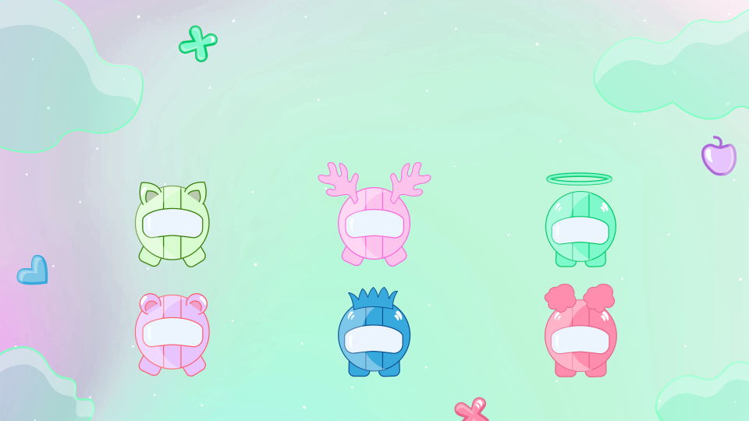
Thanks!
Thanks!
Presentation by Vaishnavi Sinha C22019221466
3467
T.Y.B.Tech. 2021-22
Special Thanks to my Seminar Guide Dr. Anjali M. Naik

Slide 16
FAQs
FAQs
Do you have any questions?

